Slide 1

Finding Donors
Başak Dilara Çevik
Original Author: Sajal Sharma
Project Link: GitHub

Slide 2

MIT License
Copyright (c) 2017 Sajal Sharma
Permission is hereby granted, free of charge, to any person obtaining a copy of this software and associated documentation files (the "Software"), to deal in the Software without restriction, including without limitation the rights to use, copy, modify, merge, publish, distribute, sublicense, and/or sell copies of the Software, and to permit persons to whom the Software is furnished to do so, subject to the following conditions:
The above copyright notice and this permission notice shall be included in all copies or substantial portions of the Software.
THE SOFTWARE IS PROVIDED "AS IS", WITHOUT WARRANTY OF ANY KIND, EXPRESS OR IMPLIED, INCLUDING BUT NOT LIMITED TO THE WARRANTIES OF MERCHANTABILITY, FITNESS FOR A PARTICULAR PURPOSE AND NONINFRINGEMENT. IN NO EVENT SHALL THE AUTHORS OR COPYRIGHT HOLDERS BE LIABLE FOR ANY CLAIM, DAMAGES OR OTHER LIABILITY, WHETHER IN AN ACTION OF CONTRACT, TORT OR OTHERWISE, ARISING FROM, OUT OF OR IN CONNECTION WITH THE SOFTWARE OR THE USE OR OTHER DEALINGS IN THE SOFTWARE.

Slide 3
Contents
1-) Loading the necessary libraries
2-) Project & Data Exploration
3-) Data Preparation
4-) Data Preprocessing
5-) Shuffle and Split Data
6-) Evaluating Model Performance
7-) Model Tuning
8-) Feature Importance
9-) Feature Selection
10-) References

Slide 4
1-) Loading the necessary libraries
numpy
pandas
time
IPython.display
visuals
seaborn
matplotlib.pyplot

Slide 5
2-) Project & Data Exploration
Dataset (1994-Census Data)
The dataset was donated by Ron Kohavi and Barry Becker, after being published in the article "Scaling Up the Accuracy of Naive-Bayes Classifiers: A Decision-Tree Hybrid".
Project Goal
Categorical Columns Analysis
Numerical Columns Analysis

Slide 6
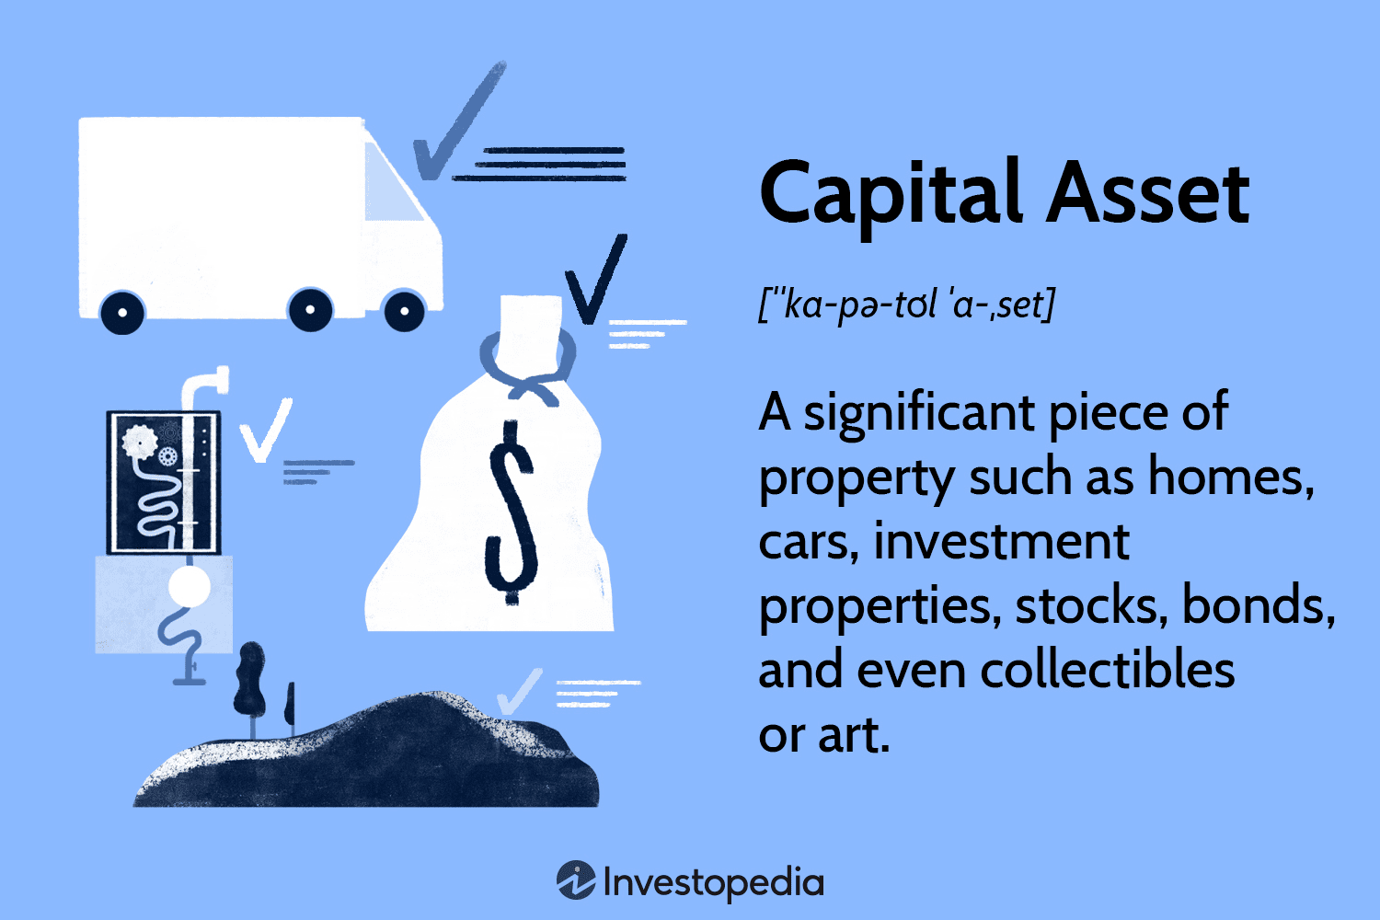
Dataset
Dua, D. and Graff, C. (2019). UCI Machine Learning Repository [http://archive.ics.uci.edu/ml]. Irvine, CA: University of California, School of Information and Computer Science
age: the age of an individual
Integer greater than 0. continuous
workclass: a general term to represent the employment status of an individual
Private, Self-emp-not-inc, Self-emp-inc, Federal-gov, Local-gov,
State-gov, Without-pay, Never-worked.
education: the highest level of education achieved by an individual.
Bachelors, Some-college, 11th, HS-grad, Prof-school, Assoc-acdm, Assoc-voc, 9th, 7th-8th, 12th, Masters, 1st-4th, 10th, Doctorate, 5th-6th, Preschool.
education-num: the highest level of education achieved in numerical form. (continuous)
marital-status: marital status of an individual. Married­civ­spouse corresponds to a civilian spouse while Married­AF­spouse is a spouse in the Armed Forces.
Married-civ-spouse, Divorced, Never-married, Separated, Widowed, Married-spouse-absent, Married-AF-spouse.
sex: the biological sex of the individual.
Female, Male.
occupation: the general type of occupation of an individual.
Tech-support, Craft-repair, Other-service, Sales, Exec-managerial, Prof-specialty, Handlers-cleaners, Machine-op-inspct, Adm-clerical, Farming-fishing, Transport-moving, Priv-house-serv, Protective-serv, Armed-Forces.
relationship: represents what this individual is relative to others.
Wife, Own-child, Husband, Not-in-family, Other-relative, Unmarried.
race: descriptions of an individual’s race.
White, Asian-Pac-Islander, Amer-Indian-Eskimo, Other, Black.
capital-gain: capital gains for an individual. When a capital asset such as such as real estate, vehicles, machinery, or other long-lived assets are sold at profit. (continuous)
capital-loss: capital loss for an individual. It occurs when a capital asset a vehicle, computer, or piece of real estate or furniture is sold for less than its basis. (continuous)
hours-per-week: the hours an individual has reported to work per week. (continuous)
native-country: country of origin for an individual.
United-States, Cambodia, England, Puerto-Rico, Canada, Germany, Outlying-US(Guam-USVI-etc), India, Japan, Greece, South, China, Cuba, Iran, Honduras, Philippines, Italy, Poland, Jamaica, Vietnam, Mexico, Portugal, Ireland, France, Dominican-Republic, Laos, Ecuador, Taiwan, Haiti, Columbia, Hungary, Guatemala, Nicaragua, Scotland, Thailand, Yugoslavia, El-Salvador, Trinadad&Tobago, Peru, Hong, Holand-Netherlands.
income: whether an individual makes more than $50,000 annually.
<=50K, >50K.

Slide 7

Project Goal
The goal of this project is to predict if an individual makes over than $50.000 a year according to data collected from the 1994 U.S. Census.
This implementation aims to construct a model for an accurate prediction.
It could be beneficial for donations in a non-profit setting.
It is a classification problem.

Slide 8
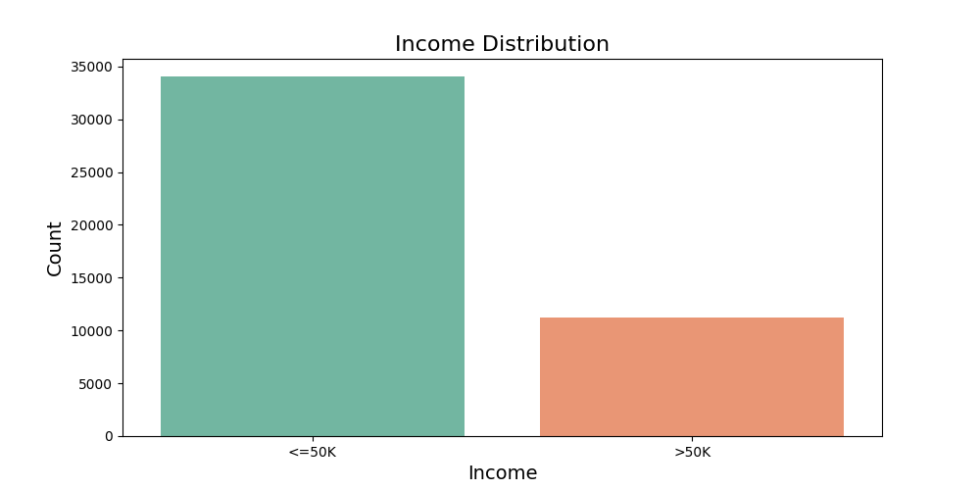
The number of people with income less than or equal to 50K is higher than the number of people with income more than 50K.
Categorical Features Analysis
Addition

Slide 9
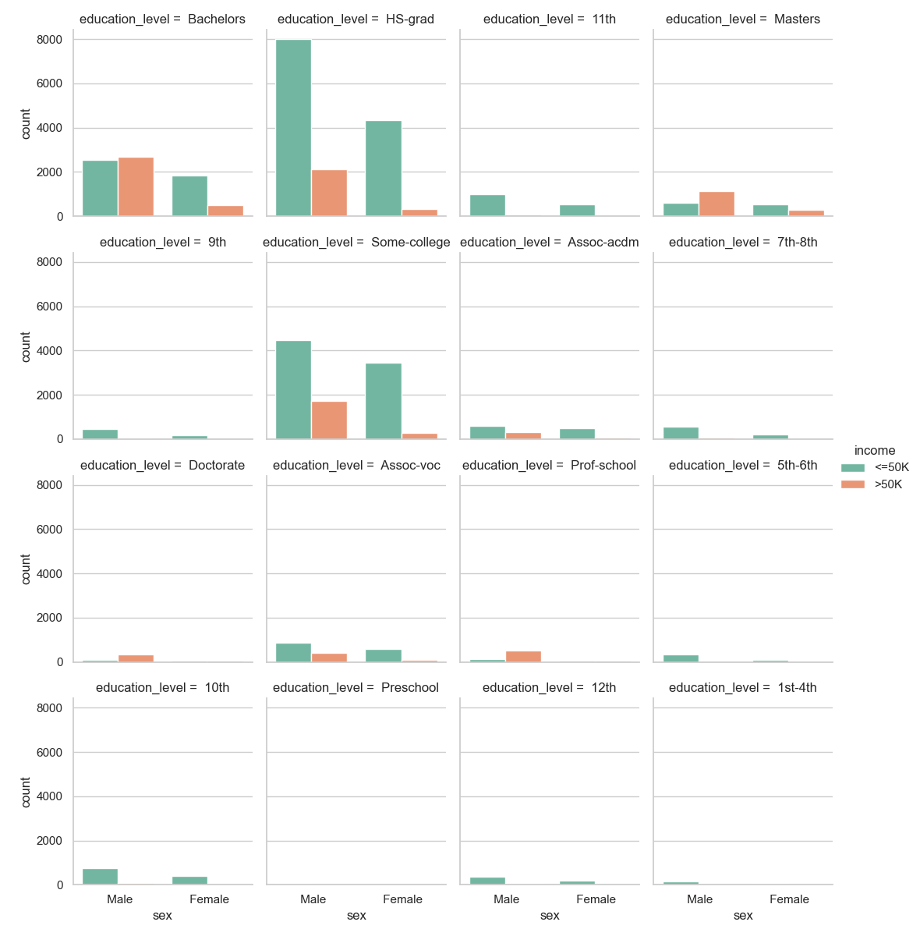
Income & Education Level Relationship by Gender

Slide 10
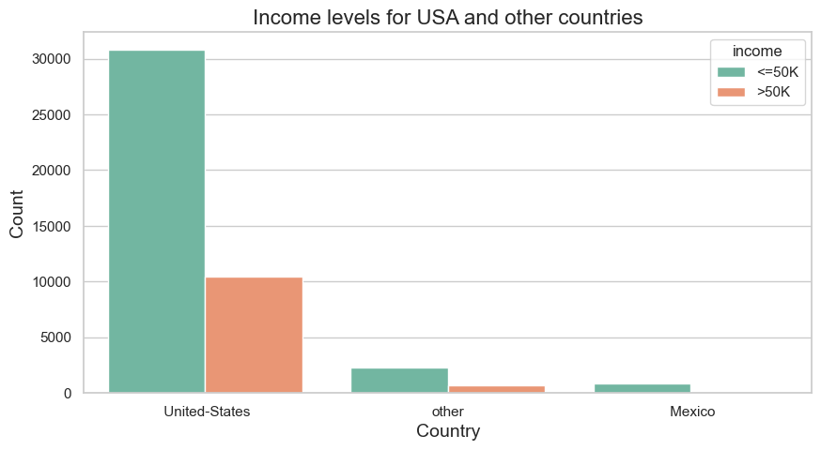
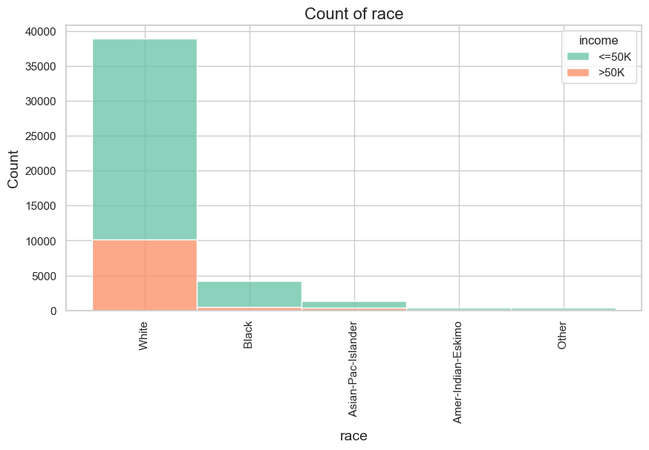
INCOME LEVELS FOR SELECTED CATEGORICAL VARIABLES
Addition
Income levels for USA, Mexico and other countries:
Income levels for each race (ethnicity):

Slide 11
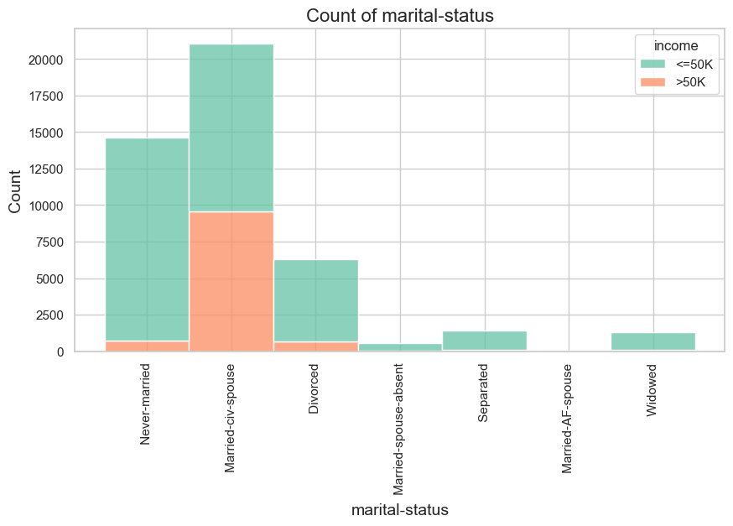
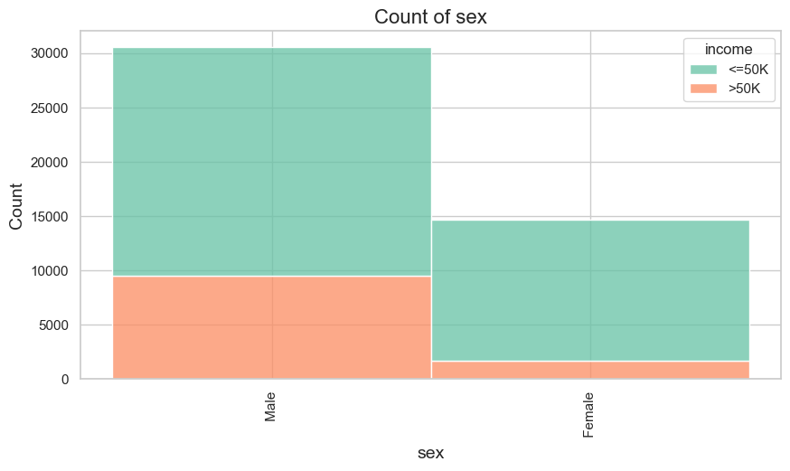
Addition
Income levels for each marital status:
Income levels for each sex:
Notes:
Married-civ spouse’da 50.000 altı, 50.000 üstünün yarısı

Slide 12
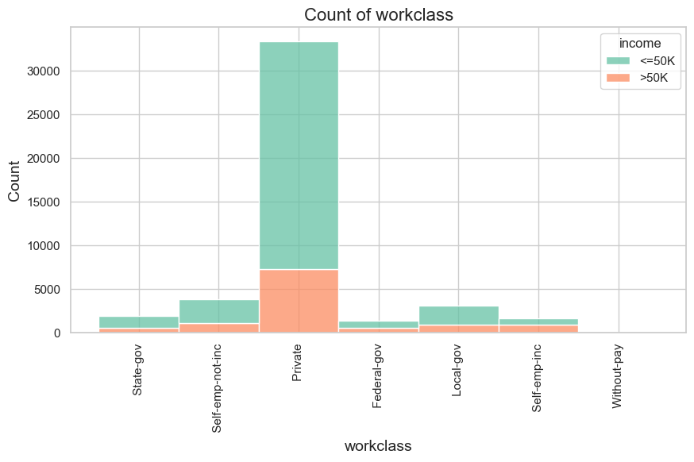
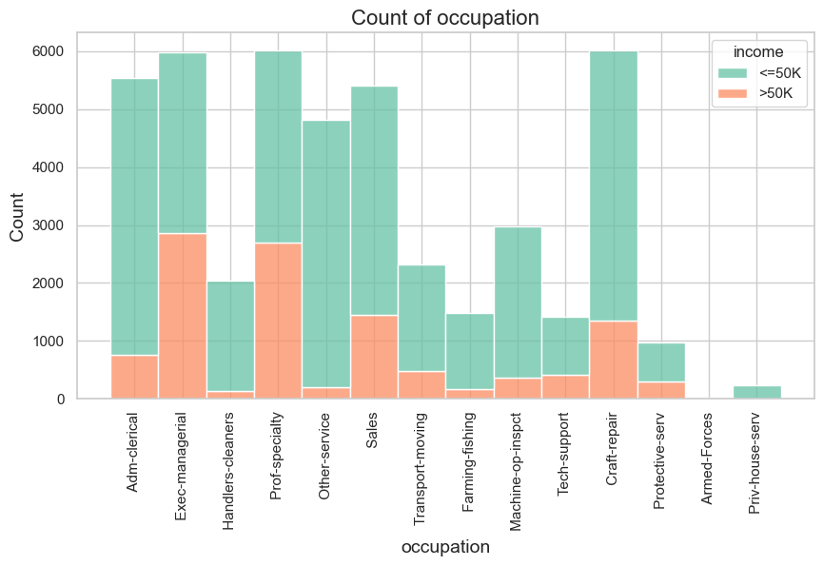
Addition
Income levels for each workclass:
Income levels for each occupation:

Slide 13
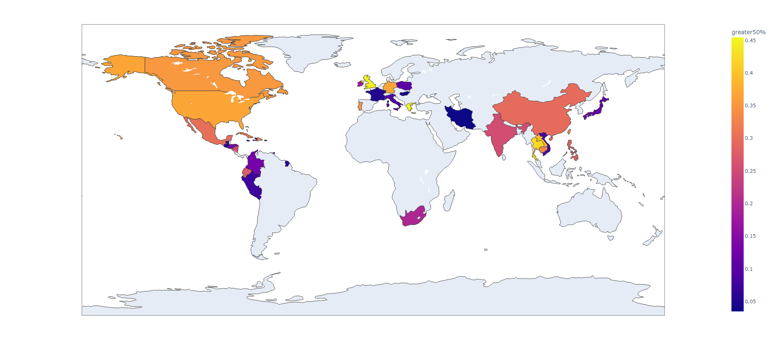
A choropleth map
Addition
The percentage of people who earn more than 50000
-> In the US, it is 36.81%

Slide 14
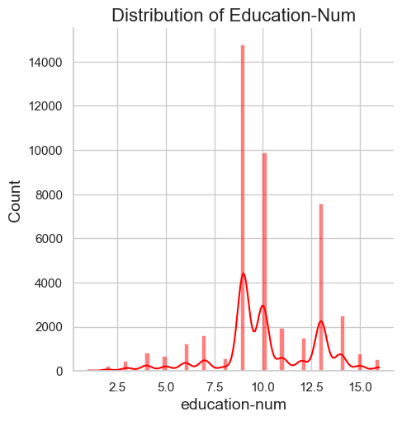
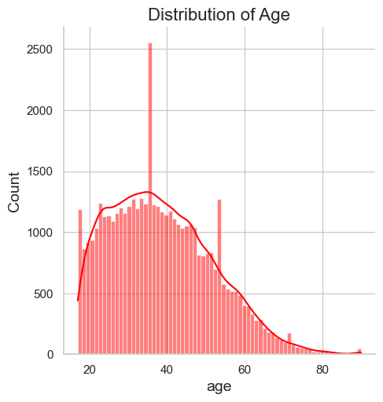
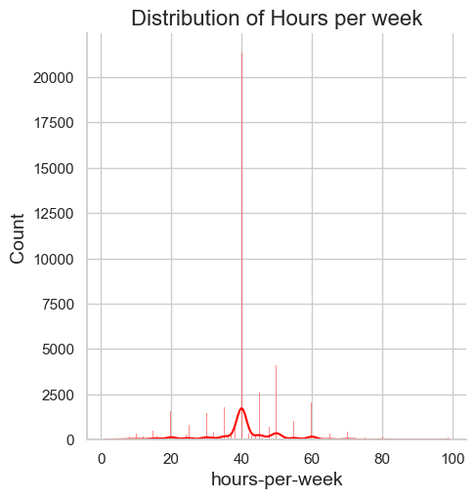
Addition
Numerical Features Analysis
Education number, age, and hours per week features are close to normal distribution.

Slide 15
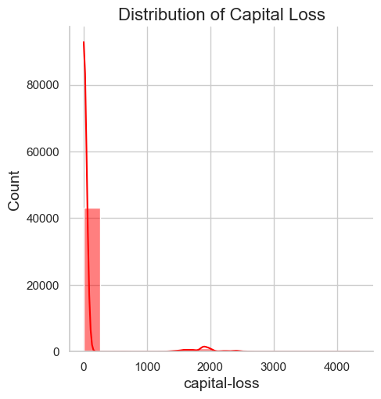
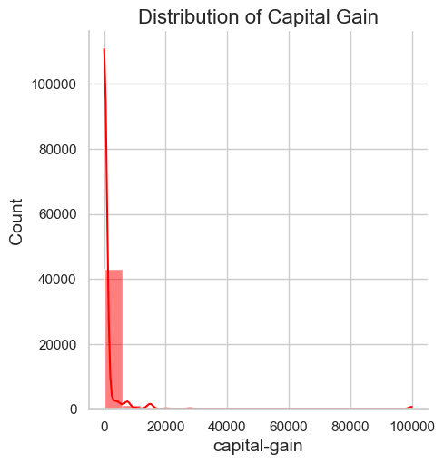
Addition
Distributions of capital gain and capital loss are right-skewed.
Notes:
A dataset may sometimes contain at least one feature whose values tend to lie near a single number, but will also have a non-trivial number of vastly larger or smaller values than that single number. Algorithms can be sensitive to such distributions of values and can underperform if the range is not properly normalized. With the census dataset two features fit this description: 'capital-gain' and 'capital-loss'.

Slide 16
3-) Data Preparation
Log-transform the skewed features
Skewness indicates whether the data is concentrated on one side. If the mean is lower than the median it is left-skewed (negative skew). Because outliers are to the left.
«Log transformation is a data transformation method in which it replaces each variable x with a log(x).
The most popular among the different types of transformations used to transform skewed data to approximately conform to normality.»
Normalizing numerical features
«Normalization typically means rescaling the values into a range of [0,1]
It aims to reduce the weight of higher numbers.
If we know a variable is significantly more important than the other we shouldn’t use normalization or standardization.»
Notes:
In addition to performing transformations on features that are highly skewed, it is often good practice to perform some type of scaling on numerical features. Applying a scaling to the data does not change the shape of each feature's distribution (such as 'capital-gain' or 'capital-loss' above); however, normalization ensures that each feature is treated equally when applying supervised learners.
The fit method is calculating the mean and variance of each of the features present in our data. The transform method is transforming all the features using the respective mean and variance.

Slide 17
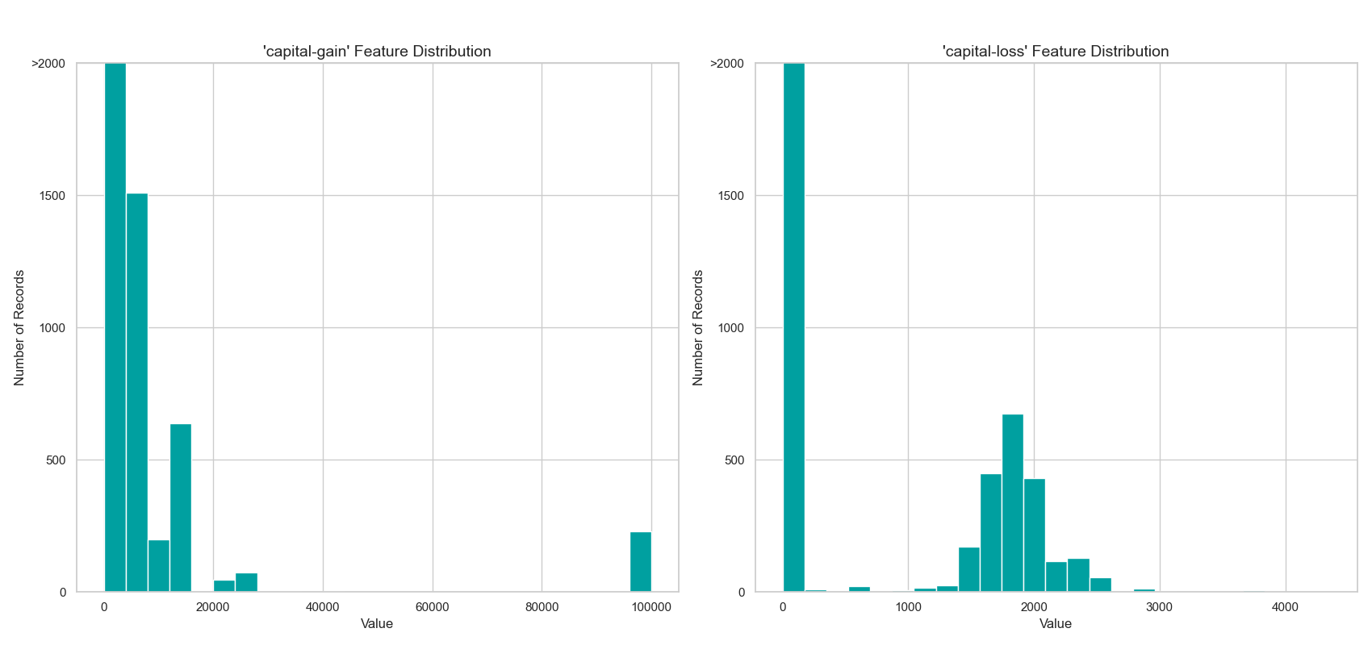
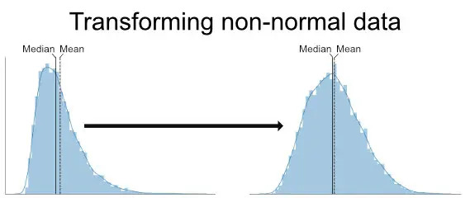
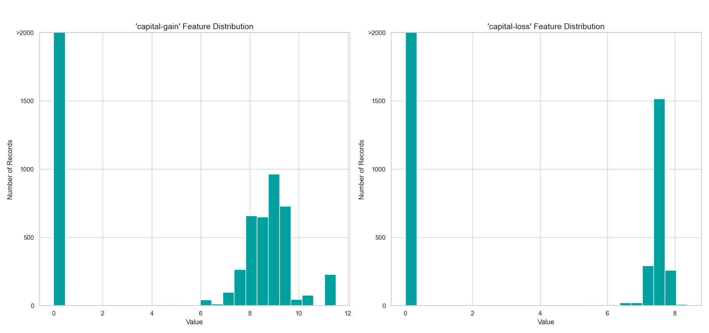
Transforming Skewed Continuous Features

Slide 18
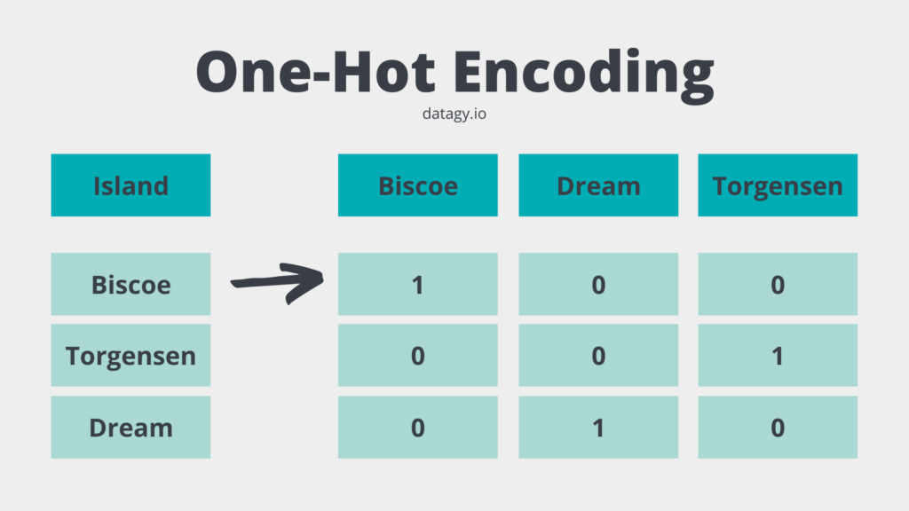
4-) Data Pre-processing
one-hot-encoding: It converts categorical variables into numerical ones by creating a «dummy» variable for each possible category of its non-numeric features.
encoding: Encode the 'income_raw' data to numerical values. If income is greater than $50.000 it is equal to 1, otherwise it is equal to 0.
103 total features after one-hot encoding.

Slide 19
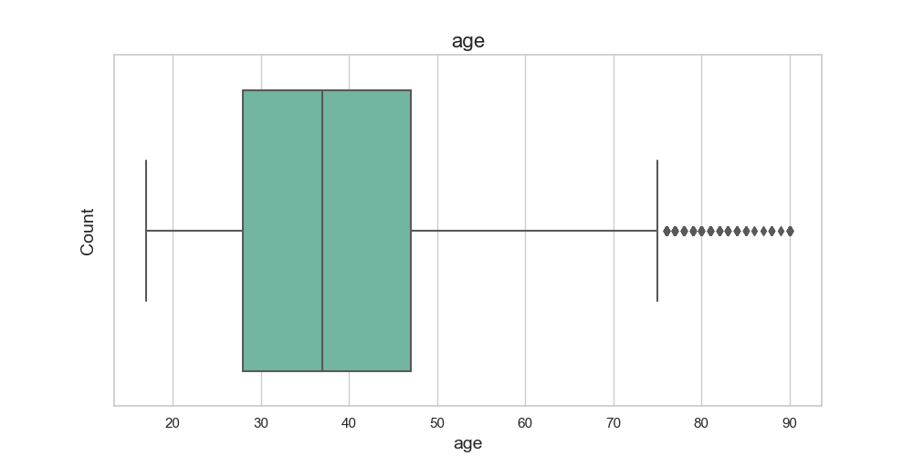
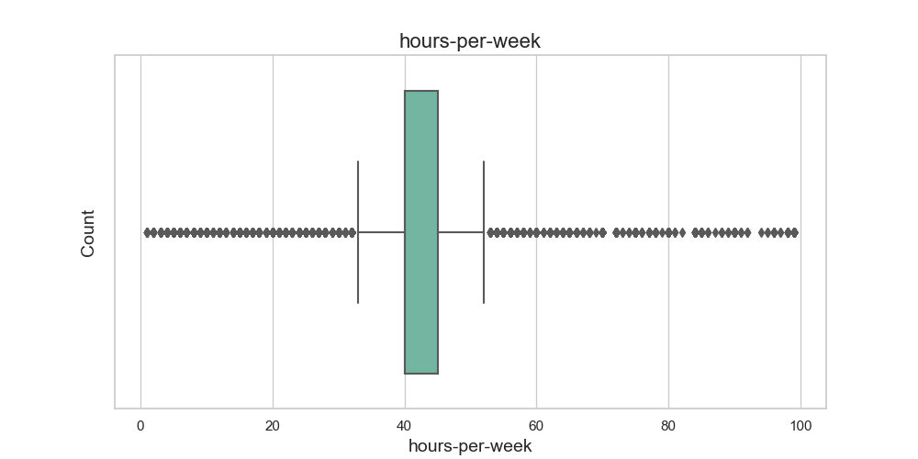
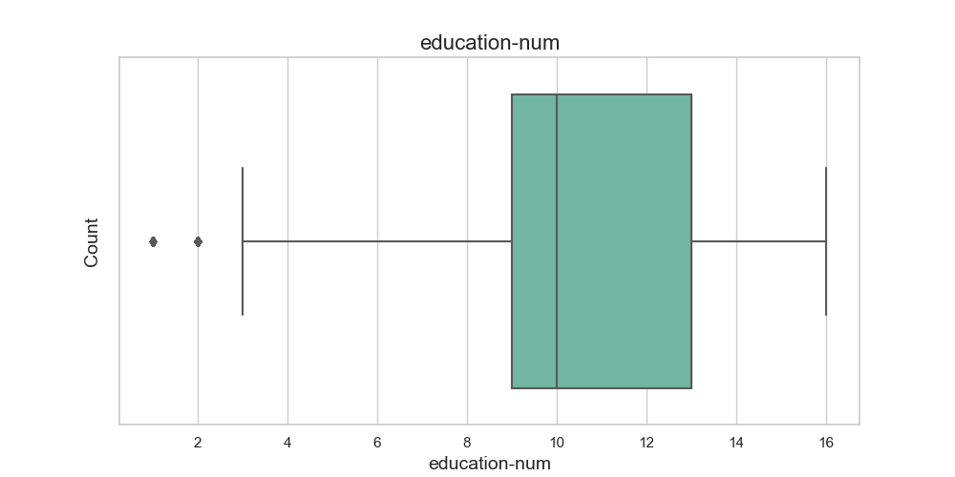
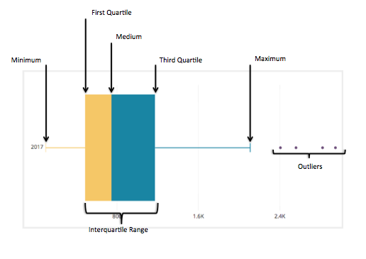
Addition
Outlier Detection
There are outlier problems, especially in hours per week and age features.

Slide 20
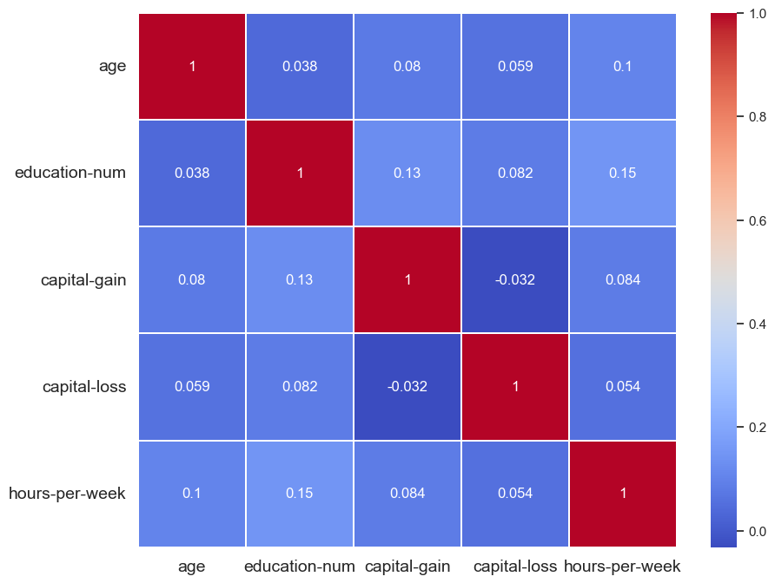
Addition
Correlation Matrix
There is no significant correlation between numerical variables.

Slide 21
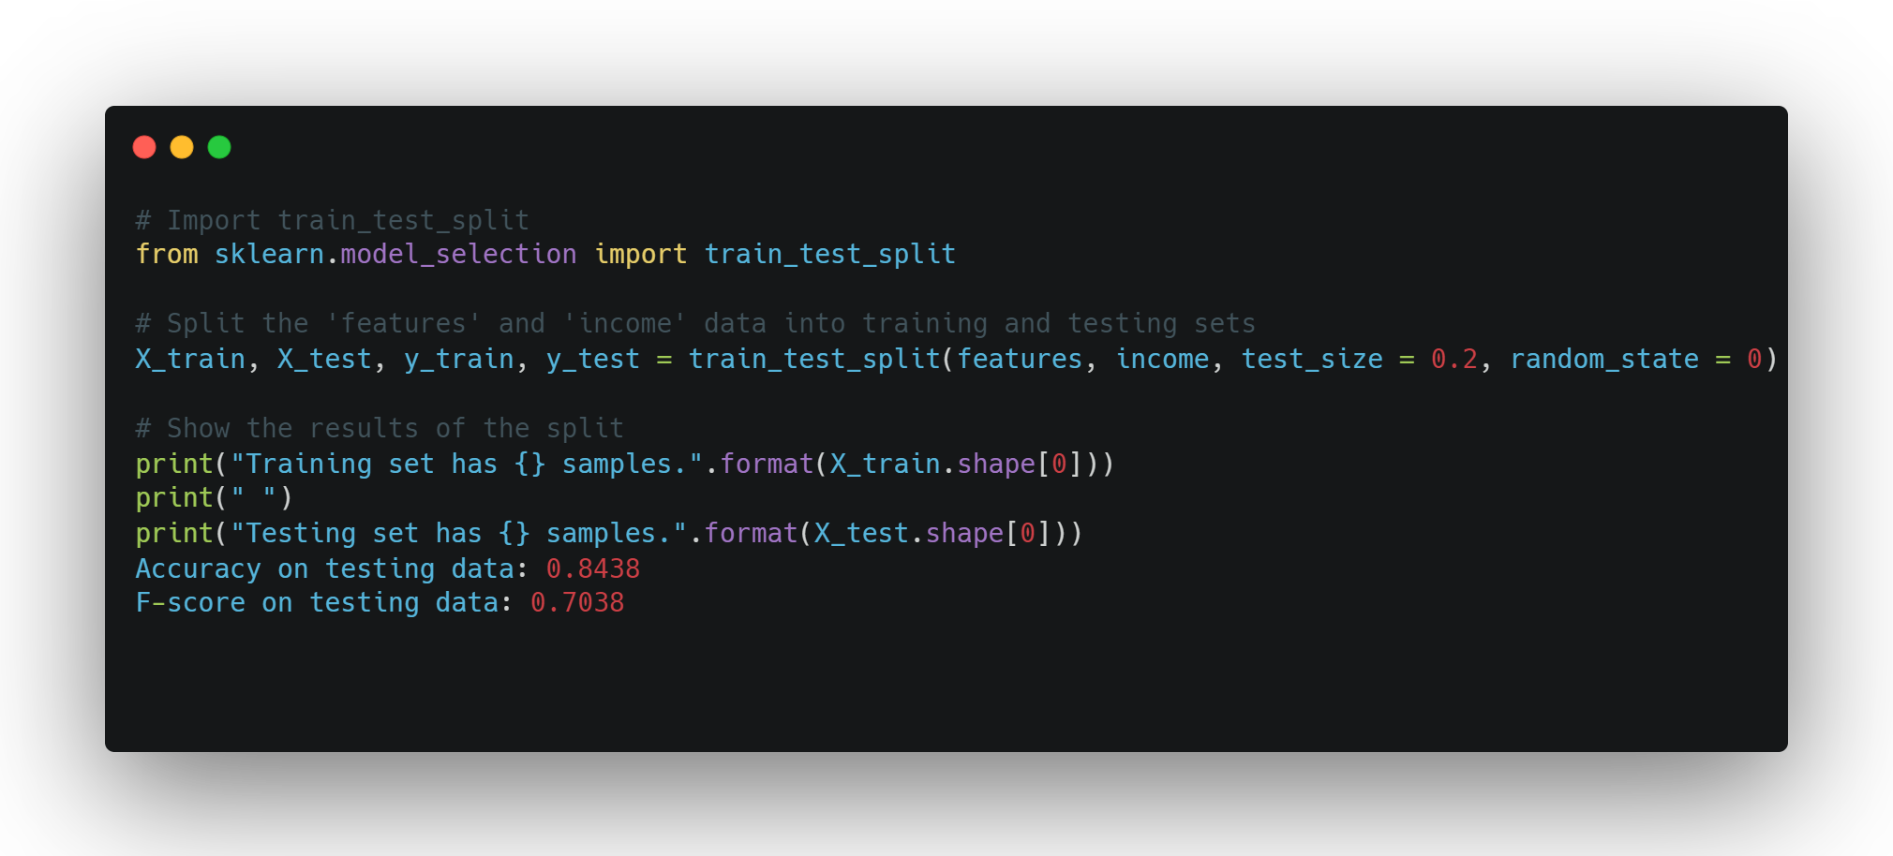
5-) Shuffle and Split Data
80% of the data will be used for training and 20% for testing.
The training set has 36177 samples. The testing set has 9045 samples.

Slide 22
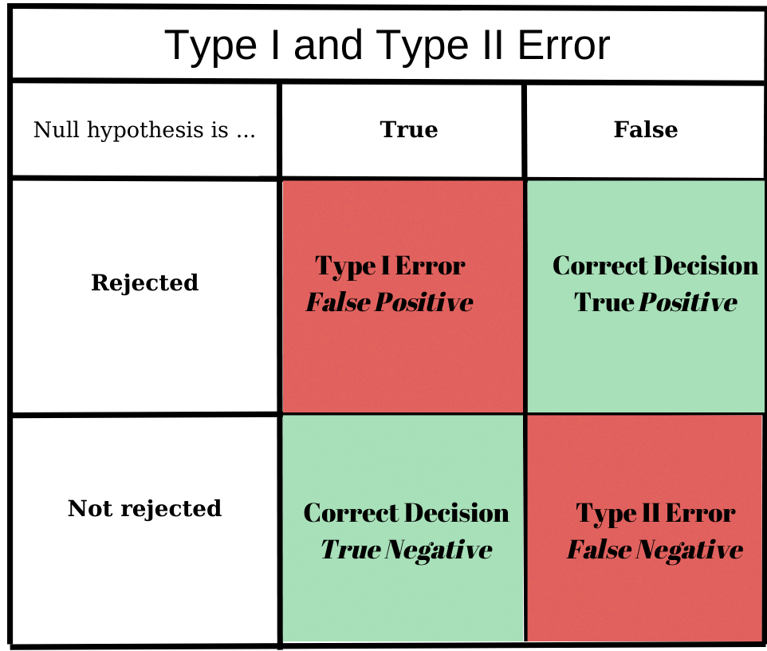
Recall – Precision – F1 Score - Accuraccy
Addition
Precision
Of all positive predictions,
how many are really positive?
TP/(TP+FP)
Recall
Of all real positive cases,
how many are predicted positive?
TP/(TP+FN)
Accuraccy
Of all predictions,
How many are true?
(TP+TN) /(TP+TN+FP+FN)
F-beta score
The weighted harmonic mean of precision and recall
F_{ß} = (1 + ß²) * (precision * recall) / (ß² * precision) + recall
Notes:
The researchers generally tries to REJECT to null hypothesis. The null is the status quo, while the alternative is the 'change or innovation' (you are looking for this answer). Null hypothesis person makes less than 50000. If we reject it means we predict person is making more than 50000 and null hypothesis false, it means a person makes more than 50000, so we have a true positive.
Birinci tip hata doğru bir null hipotezi reddettiğimizde ortaya çıkar.
İkinci tip hata, yanlış bir null hipotezi kabul ettiğimizde ortaya çıkar.
Accuracy: Sistemde doğru olarak yapılan tahminlerin tüm tahminlere oranıdır. Bu açıdan pek güvenilir bir karşılaştırma kriteri değildir.)
Accuracy = (TP+TN) / (TP+TN+FN+FP)
Recall: Pozitif durumların ne kadar başarılı tahmin edildiğini gösterir.
Recall = TP / (TP + FN)
Precision: Pozitif olarak tahmin edilen bir durumdaki başarıyı gösteren durum.
Precision = TP / (TP + FP)
F-Meaure: Recall ve Precision’ın harmonik ortalaması.

Slide 23

Addition
F0.5 score ( ß = 0.5): Such a beta makes a Precision value more important than a Recall one. It focuses on minimizing False Positives than minimizing False Negatives.
F1 score (ß = 1): True harmonic mean of Precision and Recall. In the best-case scenario, if Precision and Recall are equal to 1, the F-1 score will also be equal to 1.
F2 score (ß = 2): Such a beta makes a Recall value more important than a Precision one. It focuses on minimizing False Negatives than minimizing False Positives.
Predicted more than $50.000
Actually more than $50.000
Predicted more than $50.000
Actually less than $50.000
Predicted less than $50.000
Actually less than $50.000
Predicted less than $50.000
Actually more than $50.000

Slide 24
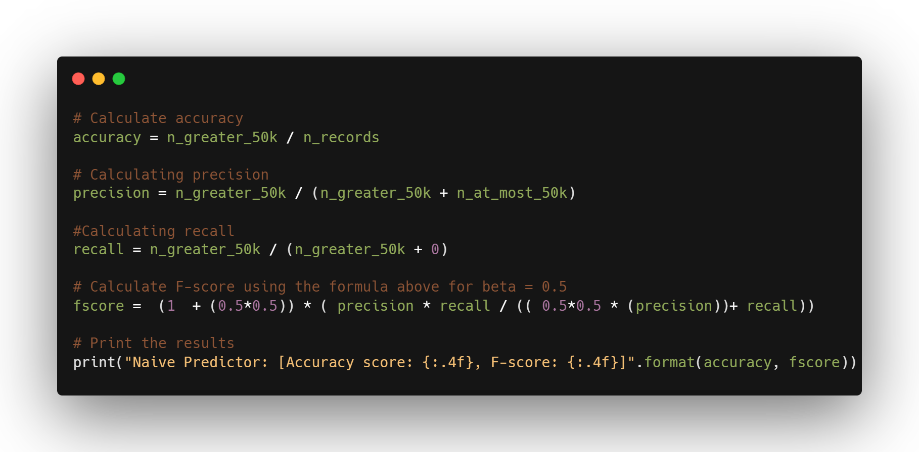
6-) Evaluating Model Performance
Naive Predictor [Accuracy score: 0.2478, F-score: 0.2917]
The F-beta score is the weighted harmonic mean of precision and recall, reaching its optimal value at 1 and its worst value at 0.
«A naive classifier model is one that does not use any sophistication (the quality of being complicated or made with great skill) in order to make a prediction, typically making a random or constant prediction. Such models are naive because they don't use any knowledge about the domain or any learning in order to make a prediction.»

Slide 25
Supervised Learning Models (Model Application)
Decision Trees
DecisionTreeClassifier trained on 362 samples.
DecisionTreeClassifier trained on 3618 samples.
DecisionTreeClassifier trained on 36177 samples.
Support Vector Machines (SVM)
SVC trained on 362 samples.
SVC trained on 3618 samples.
SVC trained on 36177 samples.
Ensemble methods: AdaBoost
AdaBoostClassifier trained on 362 samples.
AdaBoostClassifier trained on 3618 samples.
AdaBoostClassifier trained on 36177 samples.
Model Evaluation

Slide 26

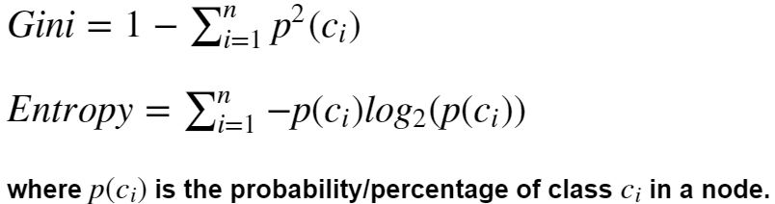
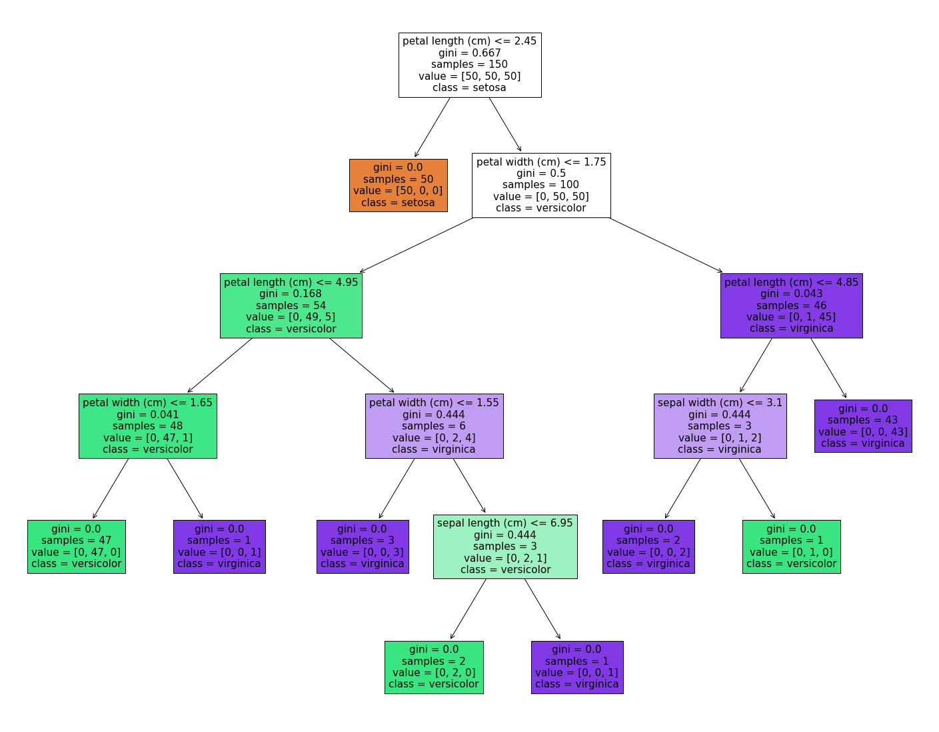
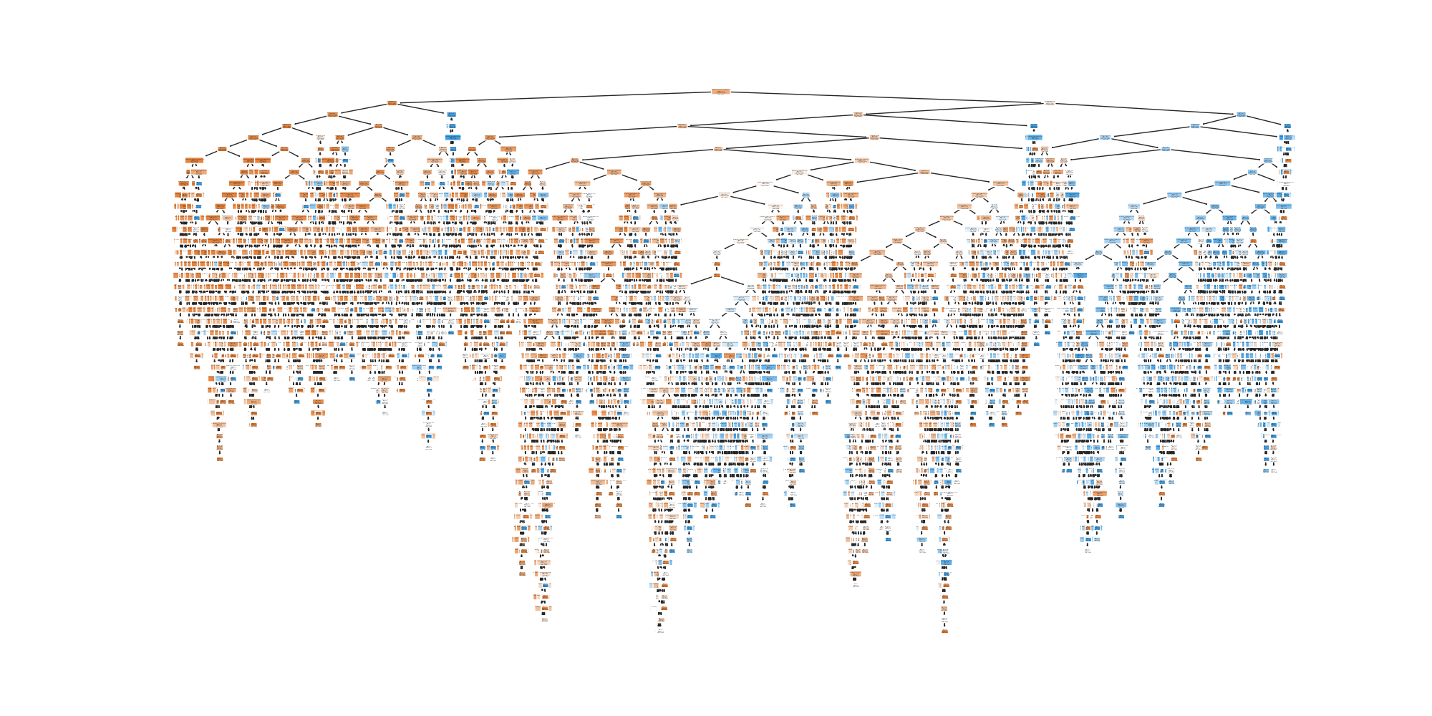
Decision Tree Classifier
1% 10% 100%
train_time 0.003999 0.019969 0.243001
pred_time 0.005970 0.007004 0.006970
acc_train 1.000000 0.996667 0.970000
acc_test 0.753344 0.804975 0.817247
f_train 1.000000 0.997191 0.963855
f_test 0.503658 0.600287 0.625174
Why decision trees?
Mimics the human level thinking
Data interpretation via its available logic
Each node -> A feature
Each branch (link) -> decision (rule)
Each leaf -> An outcome
Notes:
Strengths:
Able to handle categorical and numerical data.
Doesn't require much data pre-processing, and can handle data which hasn't been normalized, or encoded for Machine Learning Suitability.
Simple to understand and interpret.
Weaknesses:
Complex Decision Trees do not generalize well to the data and can result in overfitting.
Unstable, as small variations in the data can result in a different decision tree. Hence they are usually used in an ensemble (like Random Forests) to build robustness.
Can create biased trees if some classes dominate.
Candidacy: Since a decision tree can handle both numerical and categorical data, it's a good candidate for our case (although, the pre-processing steps might already mitigate whatever advantage we would have had). It's also easy to interpret, so we will know what happens under the hood to interpret the results.

Slide 27

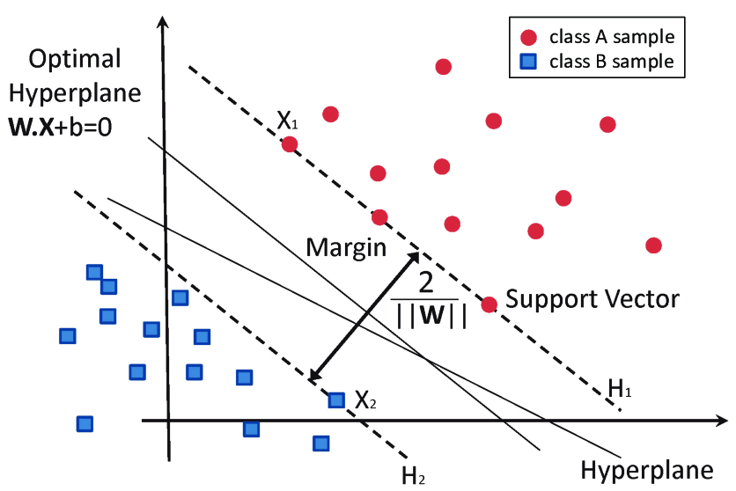
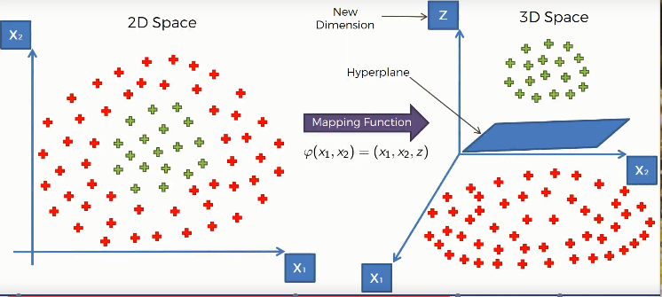
Support Vector Machines (SVM)
1% 10% 100%
train_time 0.005030 0.336958 55.709996
pred_time 0.200998 1.626036 16.180968
acc_train 0.843333 0.846667 0.840000
acc_test 0.812493 0.826645 0.836153
f_train 0.701754 0.703125 0.680147
f_test 0.609524 0.650397 0.672075
Image credit: towardsdatascience.com
Figure: Classification of data by support vector machine (SVM).⁴
Notes:
Strenghs:
Effective in high dimensional spaces, or when there are a lot of features.
Kernel functions can be used to adapt to different cases, and can be completely customized if needed. Thus SVMs are versatile.
Weaknesses:
Doesn't perform well with large datasets.
Doesn't directly provide probability estimates.
Candidacy: SVMs were chosen because of their effectiveness given high dimensionality. After incorporating dummy variables, we have more than 100 features in our dataset, so SVMs should be a classifier that works regardless of that. Also, our dataset is not that large to be a deterrent.

Slide 28
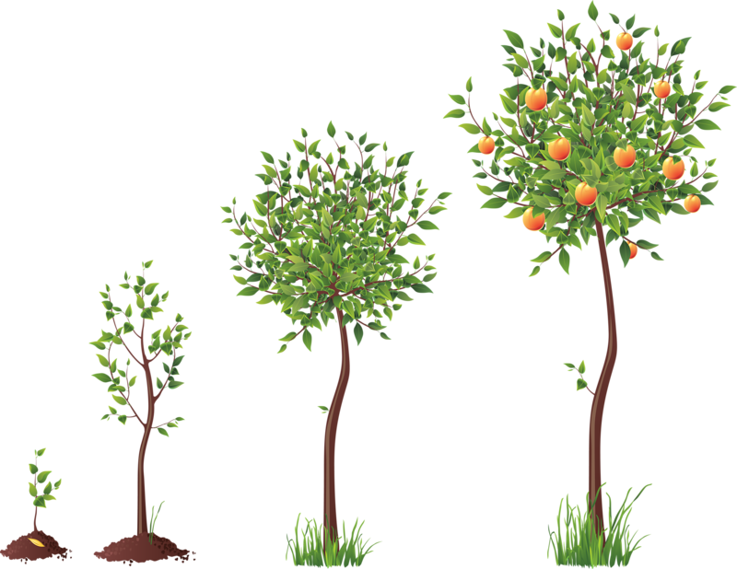
AdaBoost (Ensemble | Boosting)
1% 10% 100%
train_time 0.061999 0.200999 1.709000
pred_time 0.128032 0.122969 0.124967
acc_train 0.893333 0.856667 0.850000
acc_test 0.809840 0.850083 0.857048
f_train 0.821429 0.737705 0.711538
f_test 0.609234 0.705343 0.723062
What is boosting?
Training individual models in a sequential way. Each individual model learns from mistakes made by the previous model.
What does AdaBoost do?
AdaBoost combines a lot of ‘weak learners’ to make classifications.
Notes:
Strength:
Ensemble methods, including Adaboost are more robust than single estimators, have improved generalizability.
Simple models can be combined to build a complex model, which is computationally fast.
Weaknesses:
If we have a biased underlying classifier, it will lead to a biased boosted model.
Candidacy: Ensemble methods are considered to be high quality classifiers, and adaboost is the one of most popular boosting algorithms. We also have a class imbalance in our dataset, which boosting might be robust to.

Slide 29
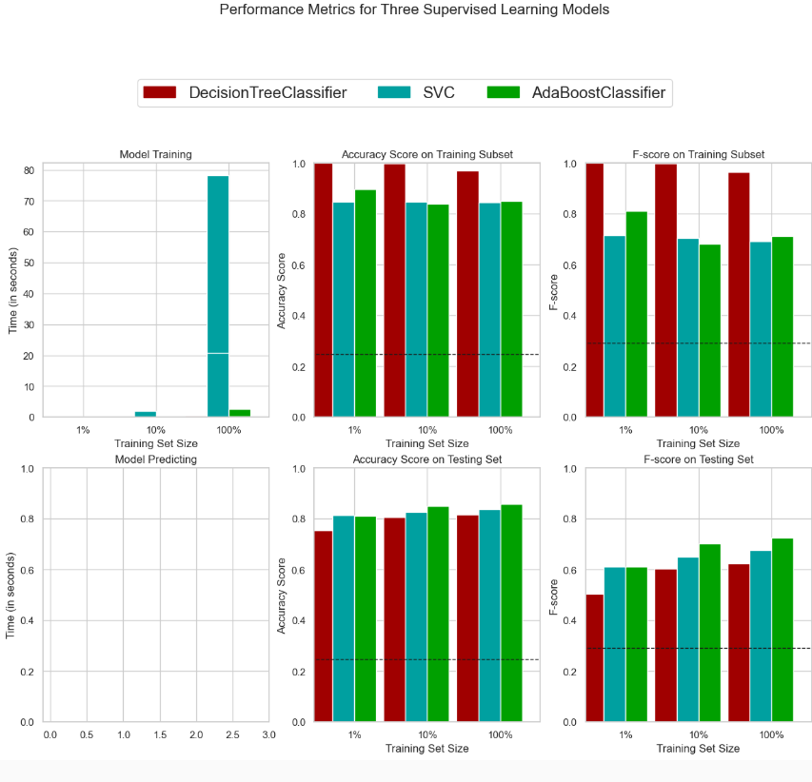

Slide 30
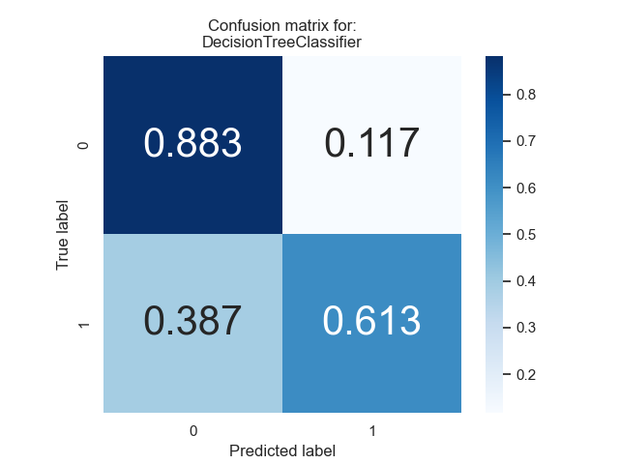
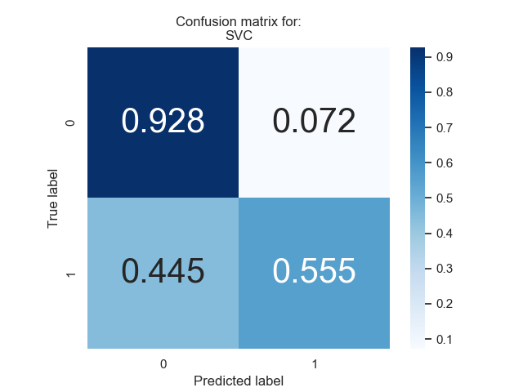

Confusion Matrix for Three Supervised Learning Models

Slide 31
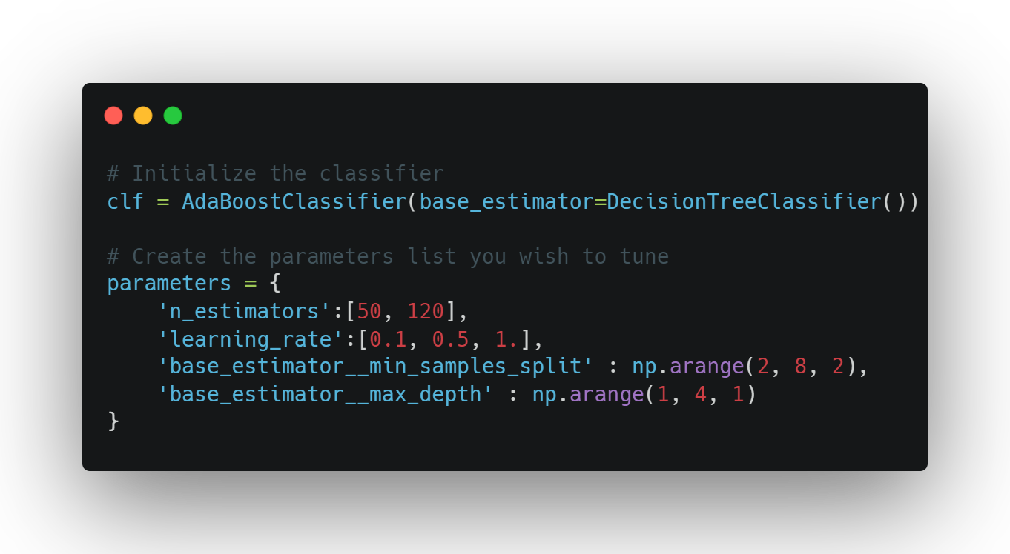
7-) Model Tuning
Final Model Evaluation
Metric | Benchmark Predictor | Unoptimized Model | Optimized Model
Accuracy Score | 0.2478 | 0.8398 | 0.8680
F-score | 0.2917 | 0.6745 | 0.7498
AdaBoostClassifier(base_estimator=DecisionTreeClassifier(max_depth=2), learning_rate=0.5, n_estimators=120)

Slide 32
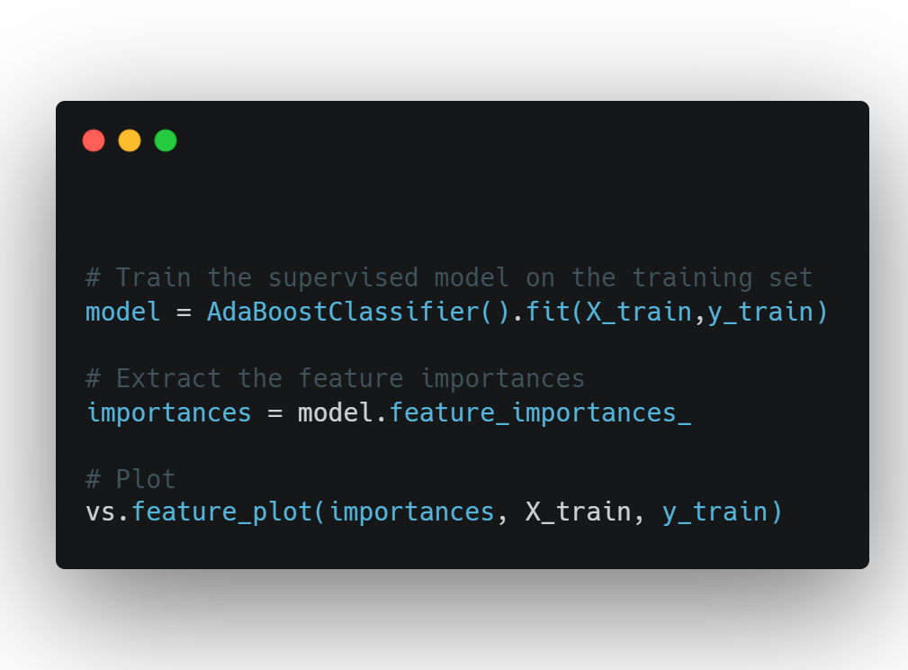
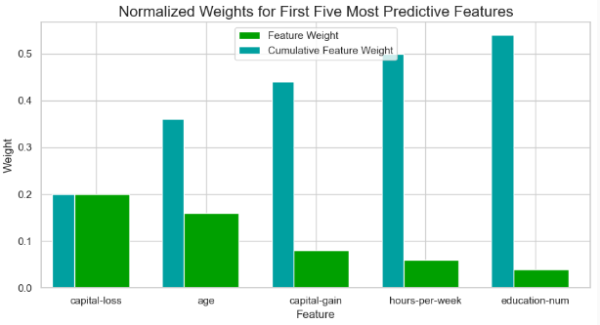
8-) Feature Importance
AdaBoost is a supervised learning model that has ‘feature_importances_’.
Top 5 predictive features:
Capital-loss
Age
Capital-gain
Hours per week
Education Number

Slide 33
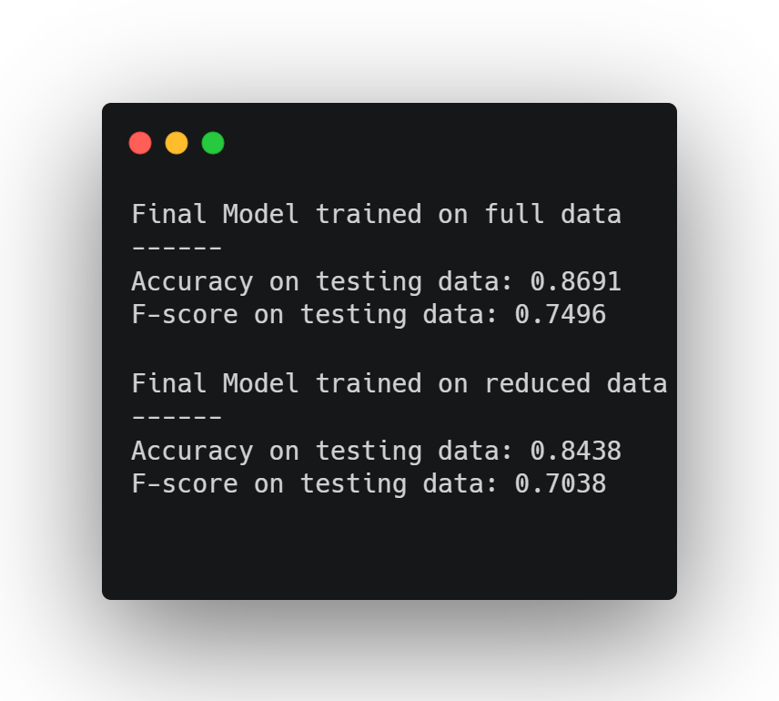

9-) Feature Selection
It is the process of reducing the input variable to a model by using only relevant data and getting rid of noise in the data.
How does it help?
1-) Hinders Overfitting
2-) Improved Accuraccy
3-) Reduce Training Time
image:Flaticon.com

Slide 34
10-) References
https://cseweb.ucsd.edu/classes/sp15/cse190-c/reports/sp15/048.pdf
https://www.ncbi.nlm.nih.gov/pmc/articles/PMC4120293/#:~:text=The%20log%20transformation%20is%2C%20arguably,normal%20or%20near%20normal%20distribution.
https://machinelearningmastery.com/how-to-develop-and-evaluate-naive-classifier-strategies-using-probability/#:~:text=A%20naive%20classifier%20model%20is,order%20to%20make%20a%20prediction.
Hard-Rock Stability Analysis for Span Design in Entry-Type Excavations with Learning Classifiers - Scientific Figure on ResearchGate. Available from: https://www.researchgate.net/figure/Classification-of-data-by-support-vector-machine-SVM_fig8_304611323 [accessed 1 Mar, 2023]

Slide 35
11-) Discussion
Strong sides:
Model Implementation
Weak sides:
Exploratory Data Analysis
Feature Engineering
What could be better?
Data Pre-processing

Slide 36
Any questions?
Başak Dilara Çevik

